Slide 1
Chapter 4: Threads

Slide 2
Chapter 4: Threads
Overview
Multicore Programming
Multithreading Models
Thread Libraries
Implicit Threading
Threading Issues
Operating System Examples

Slide 3
Motivation
Most modern applications are multithreaded
Process creation is heavy-weight while thread creation is light-weight
Can simplify code, increase efficiency
Kernels are generally multithreaded
Notes:
Threadds = workers – don’t have own memory space
- one process multiple threads working on the same process

Slide 4
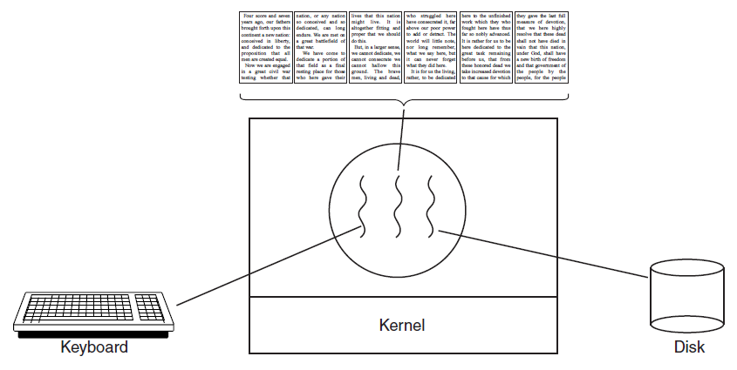
Thread Usage
A word processor with three threads.

Slide 5
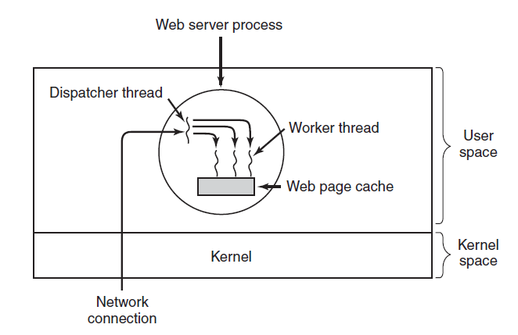
Thread Usage
A multithreaded Web server.

Slide 6
Benefits
Responsiveness – may allow continued execution if part of process is blocked, especially important for user interfaces
Resource Sharing – threads share resources of process, easier than shared memory or message passing
Economy – cheaper than process creation, thread switching lower overhead than context switching
Scalability – process can take advantage of multiprocessor architectures

Slide 7
Multicore Programming
Multicore or multiprocessor systems putting pressure on programmers, challenges include:
Dividing activities
Balance
Data splitting
Data dependency
Testing and debugging
Parallelism implies a system can perform more than one task simultaneously
Concurrency supports more than one task making progress
Single processor / core, scheduler providing concurrency

Slide 8
Multicore Programming (Cont.)
Types of parallelism
Data parallelism – distributes subsets of the same data across multiple cores, same operation on each
Task parallelism – distributing threads across cores, each thread performing unique operation
As # of threads grows, so does architectural support for threading
CPUs have cores as well as hardware threads
Consider Oracle SPARC T4 with 8 cores, and 8 hardware threads per core
https://simple.wikipedia.org/wiki/Multitasking_(iOS)
Notes:
Project 2 – run a multi-thread program

Slide 9
Concurrency vs. Parallelism
Concurrent execution on single-core system:
Parallelism on a multi-core system:

Slide 10
Single and Multithreaded Processes

Slide 11
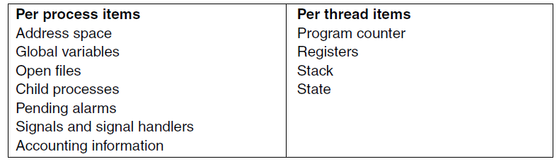
The Classical Thread Model

Slide 12
User Threads and Kernel Threads
User threads - management done by user-level threads library
Three primary thread libraries:
POSIX Pthreads
Windows threads
Java threads
Kernel threads - Supported by the Kernel
Examples – virtually all general purpose operating systems, including:
Windows
Solaris
Linux
Tru64 UNIX
Mac OS X

Slide 13
Multithreading Models
Many-to-One
One-to-One
Many-to-Many

Slide 14
Many-to-One
Many user-level threads mapped to single kernel thread
One thread blocking causes all to block
Multiple threads may not run in parallel on multicore system because only one may be in kernel at a time
Few systems currently use this model
Examples:
Solaris Green Threads
GNU Portable Threads

Slide 15
One-to-One
Each user-level thread maps to kernel thread
Creating a user-level thread creates a kernel thread
More concurrency than many-to-one
Number of threads per process sometimes restricted due to overhead
Examples
Windows
Linux
Solaris 9 and later

Slide 16
Many-to-Many Model
Allows many user level threads to be mapped to many kernel threads
Allows the operating system to create a sufficient number of kernel threads
Solaris prior to version 9
Windows with the ThreadFiber package

Slide 17
Two-level Model
Similar to M:M, except that it allows a user thread to be bound to kernel thread
Examples
IRIX
HP-UX
Tru64 UNIX
Solaris 8 and earlier

Slide 18
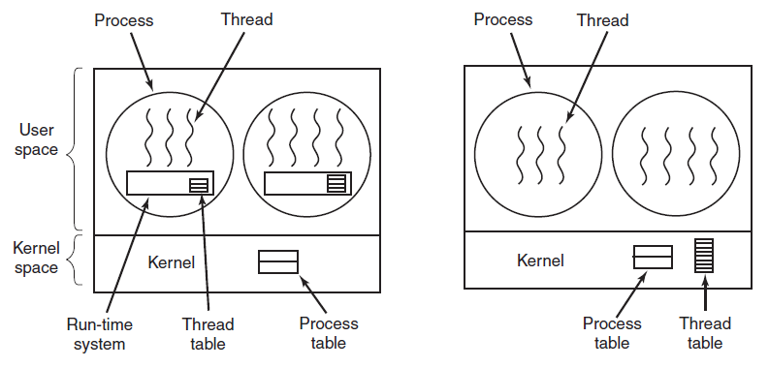
Implementing Threads
(a)
(b)
(a) A user-level threads package. (b) A threads package managed by the kernel.

Slide 19
Thread Libraries
Thread library provides programmer with API for creating and managing threads
POSIX Pthreads
Windows
Java
Two primary ways of implementing
Library entirely in user space
Kernel-level library supported by the OS
Note: The Python interpreter maps Python thread requests to either POSIX Pthreads, or Windows threads.

Slide 20
Pthreads
May be provided either as user-level or kernel-level
A POSIX standard (IEEE 1003.1c) API for thread creation and synchronization
Specification, not implementation
API specifies behavior of the thread library, implementation is up to development of the library
Common in UNIX operating systems (Solaris, Linux, Mac OS X)

Slide 21
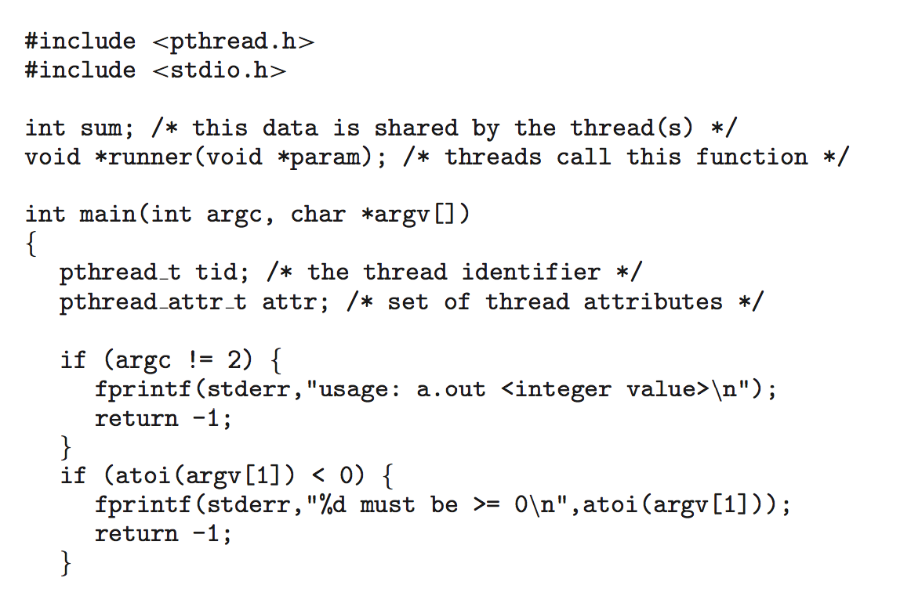
Pthreads Example

Slide 22
Pthreads Example (Cont.)

Slide 23
Pthreads Code for Joining 10 Threads

Slide 24
Implicit Threading
Growing in popularity as numbers of threads increase, program correctness more difficult with explicit threads
Creation and management of threads done by compilers and run-time libraries rather than programmers
Three methods explored
Thread Pools
OpenMP
Grand Central Dispatch
Other methods include Microsoft Threading Building Blocks (TBB), java.util.concurrent package
Notes:
mpicc -o mpi_hello_world mpi_hello_world.c
mrun -np 2 mpi_hello_world.c

Slide 25
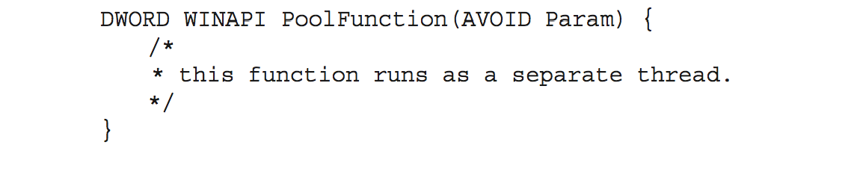
Thread Pools
Create a number of threads in a pool where they await work
Advantages:
Usually slightly faster to service a request with an existing thread than create a new thread
Allows the number of threads in the application(s) to be bound to the size of the pool
Separating task to be performed from mechanics of creating task allows different strategies for running task
i.e.Tasks could be scheduled to run periodically
Windows API supports thread pools:

Slide 26
Threading Issues
Semantics of fork() and exec() system calls
Signal handling
Synchronous and asynchronous
Thread cancellation of target thread
Asynchronous or deferred
Thread-local storage
Scheduler Activations

Slide 27
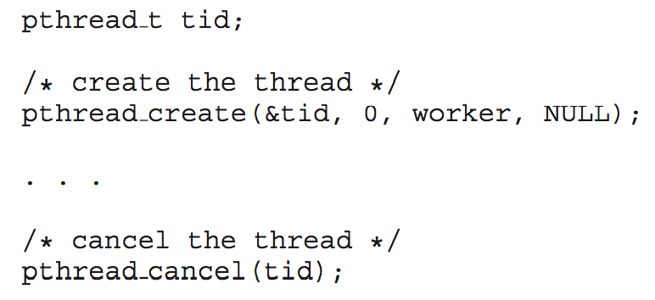
Thread Cancellation
Terminating a thread before it has finished
Thread to be canceled is target thread
Two general approaches:
Asynchronous cancellation terminates the target thread immediately
Deferred cancellation allows the target thread to periodically check if it should be cancelled
Pthread code to create and cancel a thread:

Slide 28
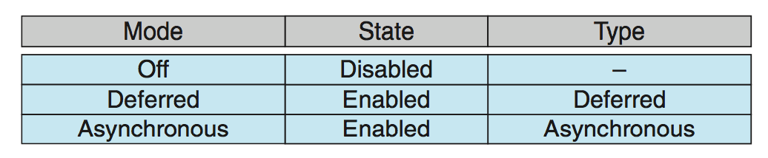
Thread Cancellation (Cont.)
Invoking thread cancellation requests cancellation, but actual cancellation depends on thread state
If thread has cancellation disabled, cancellation remains pending until thread enables it
Default type is deferred
Cancellation only occurs when thread reaches cancellation point
i.e. pthread_testcancel()
Then cleanup handler is invoked
On Linux systems, thread cancellation is handled through signals

Slide 29
Thread-Local Storage
Thread-local storage (TLS) allows each thread to have its own copy of data
Useful when you do not have control over the thread creation process (i.e., when using a thread pool)
Different from local variables
Local variables visible only during single function invocation
TLS visible across function invocations
Similar to static data
TLS is unique to each thread

Slide 30
Linux Threads
Linux refers to them as tasks rather than threads
Thread creation is done through clone() system call
clone() allows a child task to share the address space of the parent task (process)
Flags control behavior
struct task_struct points to process data structures (shared or unique)

Slide 31
End of Chapter 4

